Slide 1




DEPARTMENT OF ARTIFICIAL INTELLIGENCE AND DATA SCIENCE
Hotel Booking Price Prediction Model using IBM SPSS
Leveraging IBM SPSS for Accurate Pricing Insights

Slide 2

Team Members:
PRASANTH K R [927622BAD042]
KISHAN KUMAR S [927622BAD032]
RITHISH R M [927622BAD046]
Guided by:
Ms. SUBHASRI S
IBM

Slide 3

INTRODUCTION
Hotel prices vary based on multiple factors, making it challenging for travelers to find the best deals. Many people struggle to predict price fluctuations, which can lead to overspending or missed opportunities. Traditional price analysis methods take time and may not keep up with market trends. IBM SPSS, a powerful data analysis tool, can help analyze historical pricing data, identify key patterns, and predict future hotel prices. This project aims to develop a smart hotel booking price prediction model using IBM SPSS to assist travelers in making informed decisions.

Slide 4

Problem Statement:
Hotel prices change frequently due to various factors, making it difficult for travelers to predict the best time to book. Many people end up overpaying or missing out on better deals because they lack accurate price forecasting. Traditional methods of price analysis are time-consuming and often unreliable. Some systems rely on basic trends or fixed rules, which do not adapt well to market fluctuations. Additionally, external factors like demand surges and special events make price prediction even more complex. This project aims to develop a smarter, data-driven approach to accurately predict hotel booking prices using IBM SPSS.

Slide 5
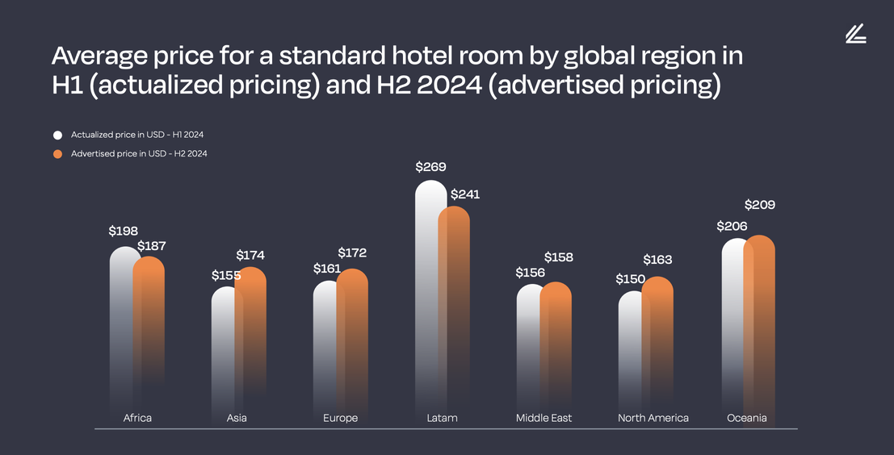
Abstract :
Hotel prices fluctuate frequently, making it challenging for travelers to find the best deals. This project utilizes IBM SPSS to predict hotel booking prices by analyzing historical data and market trends. It collects pricing data, processes relevant factors, and applies statistical models to forecast future prices. The system also generates reports and trend analysis to help users make informed booking decisions. The goal is to develop a reliable and data-driven solution for accurate hotel price predictions.

Slide 6

Objective:
The objective of this project is to predict hotel booking prices using IBM SPSS. By analyzing historical pricing data and market trends, the system aims to forecast future prices, improve prediction accuracy, and provide valuable insights through visualizations and reports. This will help travelers make informed booking decisions and optimize their travel budgets.

Slide 7
Existing System
Manual Price Estimation – Hotel prices are set based on experience, market trends, and competitor analysis without automation.
Rule-Based Pricing Models – Some hotels use predefined rules considering seasonality, location, and demand but lack flexibility.
Basic Statistical Methods – Traditional systems rely on average pricing and simple regression models, leading to less accurate predictions.
Third-Party Booking Platforms – Websites like Booking.com and Expedia provide price recommendations, but they are not personalized for individual hotels.

Slide 8
Challenges In Existing System
Frequent Price Fluctuations – Hotel prices change dynamically based on demand and seasonality.
Inconsistent Pricing – Different booking platforms show varied prices, causing confusion.
Lack of Real-Time Data – Many systems rely on outdated historical data, affecting accuracy.

Slide 9
Proposed System
This project will use IBM SPSS to analyze and predict hotel prices based on various factors.
Use data analysis to identify patterns in hotel pricing.
Predict hotel prices based on location, amenities, seasonality, and demand.
Generate reports and visualizations to help businesses and travelers make informed decisions.
Benefits
✅Faster – It processes large hotel booking datasets quickly.
✅ More accurate – It predicts prices better than traditional estimation methods.
✅ Helpful for travelers & hotel owners – Provides insights for price optimization and better budget planning.

Slide 10



MODULES IDENTIFIED
Data Collection
Collects hotel pricing data from various sources like online booking platforms, hotel websites, and Kaggle. Gathers information on factors influencing hotel prices, such as location, seasonality, and customer reviews.
Data Processing
Cleans and prepares the collected data.
Removes inconsistencies, missing values, and duplicate records to ensure high-quality input for analysis.

Slide 11

MODULES IDENTIFIED
Hotel Price Prediction
Uses IBM SPSS to analyze various factors affecting hotel prices. Applies machine learning techniques to predict prices based on location, demand, and amenities.
Visualization & Reporting
Creates graphs and reports to display price trends. Helps users understand pricing patterns and make informed booking decisions.

Slide 12
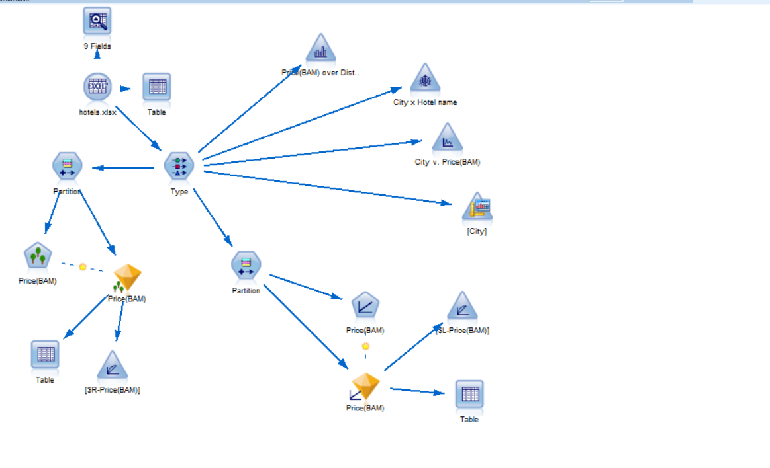
Stream:

Slide 13
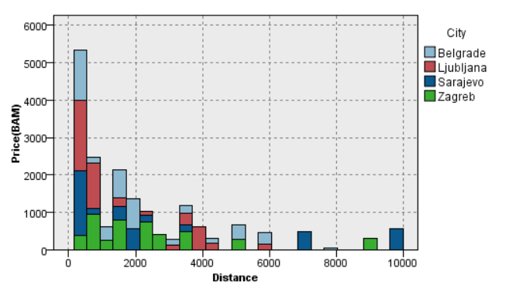
Output

Slide 14
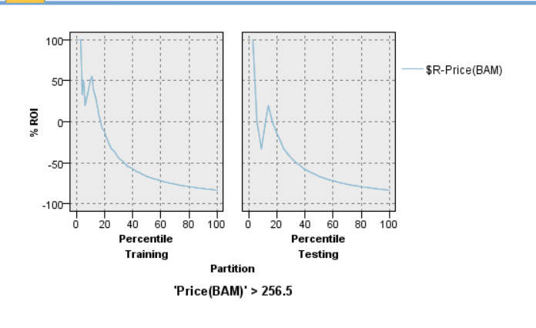
Output

Slide 15
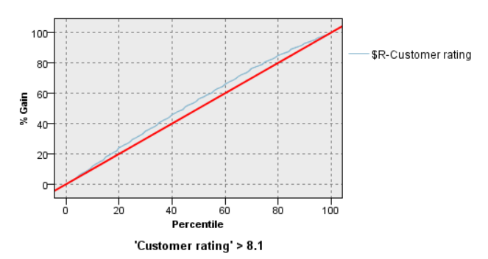
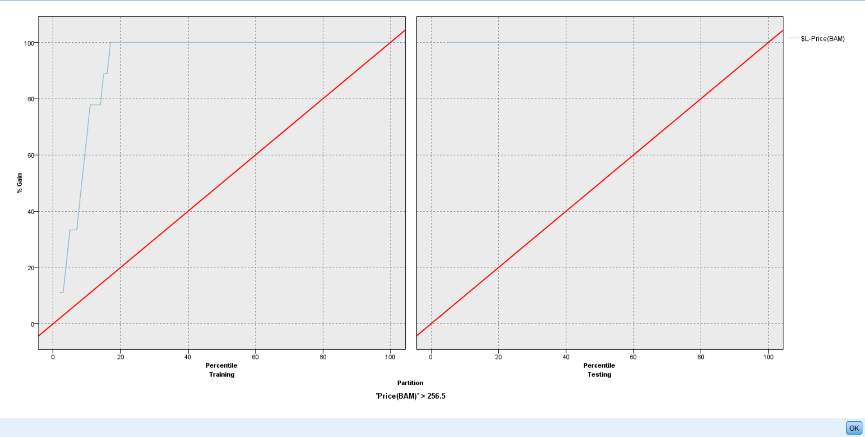
Output

Slide 16
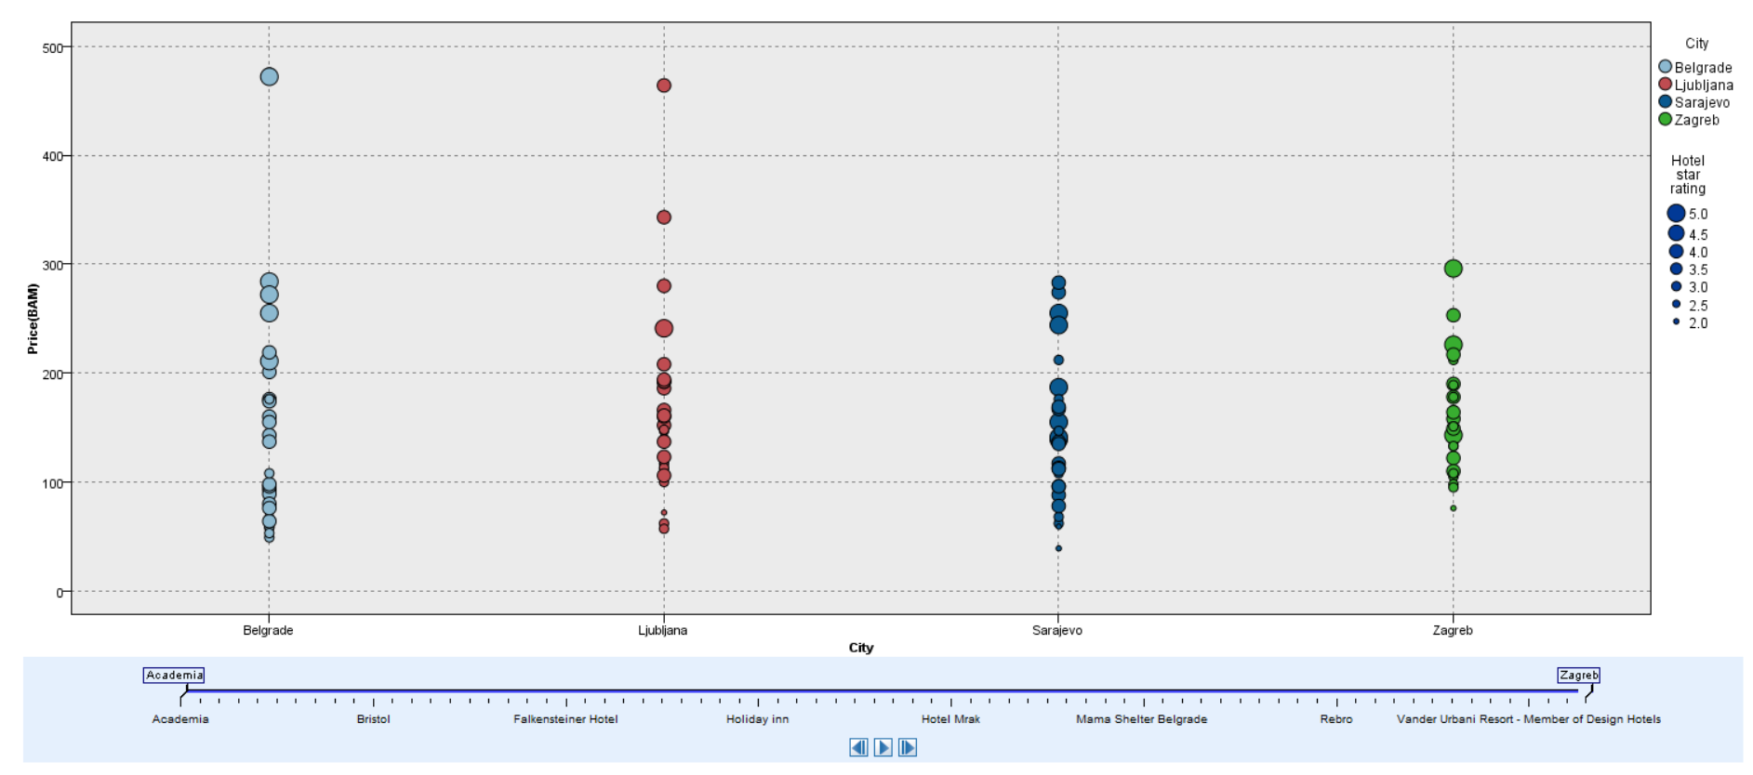
Output

Slide 17
GitHub Link:
KISHAN KUMAR - https://github.com/Kishankumar1328/Hotel-Price-Prediction
PRASANTH K R- https://github.com/prasanth-42/Hotel-Price-Prediction-SPSS
RITHISH R M - https://github.com/RMRITHISH/SPSS-modeler

Slide 18
CONCLUSION
The Hotel Booking Prediction System using IBM SPSS provides an efficient and accurate approach to forecasting hotel prices based on various influencing factors. By leveraging data analysis and machine learning, the system helps hotels optimize pricing strategies and assists travelers in making informed booking decisions. The visualization and reporting features offer clear insights into pricing trends, ensuring better decision-making for both businesses and customers.

Slide 19



